Slide 1

Introduction to Machine Learning
Supervised Learning
By

Slide 2
Confusion Matrix
<Topic>

Slide 3

Confusion Matrix
The confusion matrix shows the ways in which your classification model is confused when it makes predictions
Confusion Matrix
N=150 | Predicted Fire | Predicted Fire (Negative) | Actual
Actual Alarm (True) | TP: 40 | FP: 10 | 50
Actual Alarm (False) | FN: 5 | TN: 95 | 100
Predicted Fire | 45 | 105 | 150
Is a summary of prediction results on a classification problem
Key to Confusion Matrix: Summarize the count value of correct and i

Slide 4
Confusion Matrix
How to calculate a Confusion Matrix?
You need a test dataset or a validation dataset with expected outcome values
Make a prediction for each row in your test dataset
From the expected outcomes and predictions, count:
The number of correct predictions for each class.
The number of incorrect predictions for each class, organized by the class that was predicted

Slide 5
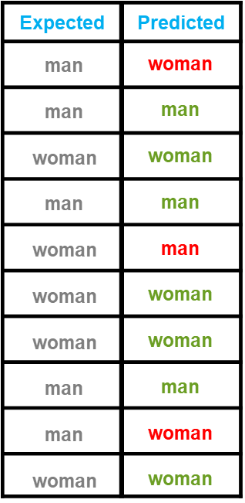
Confusion Matrix
How to calculate a Confusion Matrix?
Correct Prediction: 7/10
Accuracy: 70%

Slide 6
Confusion Matrix
How to calculate a Confusion Matrix?
men women
men
3
1
women
2
4

Slide 7
Confusion Matrix
How to calculate a Confusion Matrix?
men women
men
3
1
women
2
4
Total actual men: (3 + 2)
Total actual women: (1 +4)
Total Correct values: (3 + 4)
Conclusion: More errors while predicting men as women than predicting women as men

Slide 8

Confusion Matrix
Interpreting a Confusion Matrix
 | Predicted Fire | Predicted Fire
Alarm | True Positive | False Positive
No Alarm | False Negative | True Negative
True Positive: Alarm goes on in case of fire
False Positive: Alarm goes on but no fire
False Negative: No Alarm in case of fire
True Negative: No Alarm no Fire

Slide 9
Confusion Matrix
Interpreting a Confusion Matrix - Example
N=150 | Predicted Fire (Positive) | Predicted Fire (Negative) | Actual Alarm
Actual Alarm YES | TP: 40 | FP: 10 | 50
Actual Alarm NO | FN: 5 | TN: 95 | 100
Predicte d Fire | 45 | 105 | 150
True Positive: Alarm goes on in case of fire
False Positive: Alarm goes on but no fire
False Negative: No Alarm in case of fire
True Negative: No Alarm no Fire

Slide 10
Decision Tree & Random Forest
<Topic>

Slide 11
Decision Tree & Random Forest
Tree-based models are considered the most used supervised learning algorithms. Can be used on both classification and regression problems.
You can create highly accurate and stable predictive models
Tree-based models
Decision Trees
Random Forest

Slide 12
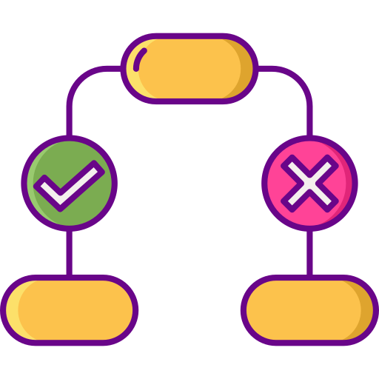
Decision Tree & Random Forest
Decision Tree
Graphical representation of all the possible solutions to a decision and it is mostly used on classification problems. Decisions are mainly based on some conditions. Decision made can be easily explained.

Slide 13
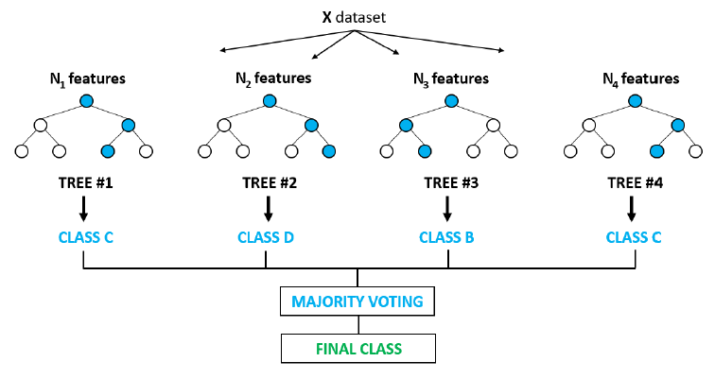
Decision Tree & Random Forest
Random Forest
Random forest builds multiple decision trees and merges them together to get a more accurate and stable prediction
It is a type of ensemble learning method, where a group of weak models combine to form a powerful model
Trained with the “bagging” method

Slide 14
Decision Tree
<Topic>

Slide 15




Decision Tree
Color | Diam | Label
Green | 3 | Mango
Yellow | 3 | Lemon
Red | 1 | Cherry
Yellow | 3 | Mango
Red | 1 | Cherry
Visualizing a Decision Tree
Gini Impurity = 0
Information Gain = 0.37
R 1
is diameter > = 3?
Gini Impurity = 0.44
Cherry R 1
G | 3 | Mango
Y | 3 | Mango
Y | 3 | Lemon
 |  |  | Information Gain = 0.11
Cherry
G 3 Mango
is colour = = Yellow?
100% Cherry
Y 3 Mango
Y 3 Lemon
100% Mango
50% Mango
50% Lemon

Slide 16

Decision Tree
Decision Tree Terminology
Pruning Opposite of Splitting, basically removing unwanted branches from the tree
Branch/SubTree
Formed by splitting the tree/node
Splitting
Parent/Child Node Root node is the parent node and all the other nodes branched from it is known as child node
Dividing the root node/sub node into different parts on the basis of some condition.
Root Node It represents the entire population or sample and this further gets divided into
two or more homogenous sets.
Leaf Node
Node cannot be further segregated into
further nodes

Slide 17
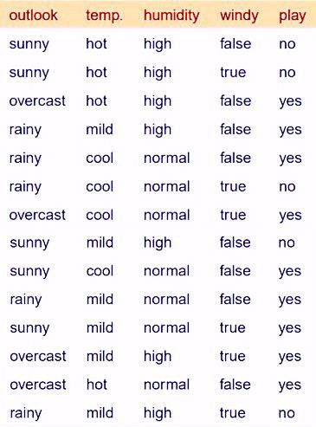
Decision Tree
This is our dataset

Slide 18
Decision Tree
How to decide, whether we will play or not?
Which one among them should you pick first?

Slide 19
Decision Tree
But How do we choose the best attribute?
Or
How does a tree decide where to split?

Slide 20

Decision Tree
Entropy
Defines randomness in the data It is a metric which measures the impurity. The first step to solve the problem of a decision tree
Information Gain
The information gain is the decrease in entropy after a dataset is split on the basis of an attribute. Constructing a decision tree is all about finding attribute that returns the highest information gain
1
2
Reduction in Variance
Reduction in variance is an algorithm used for continuous target variables (regression problems). The split with lower variance is selected as the criteria to split the population
4
3
Gini Index
The measure of impurity (or purity) used in building decision tree in CART is Gini Index

Slide 21
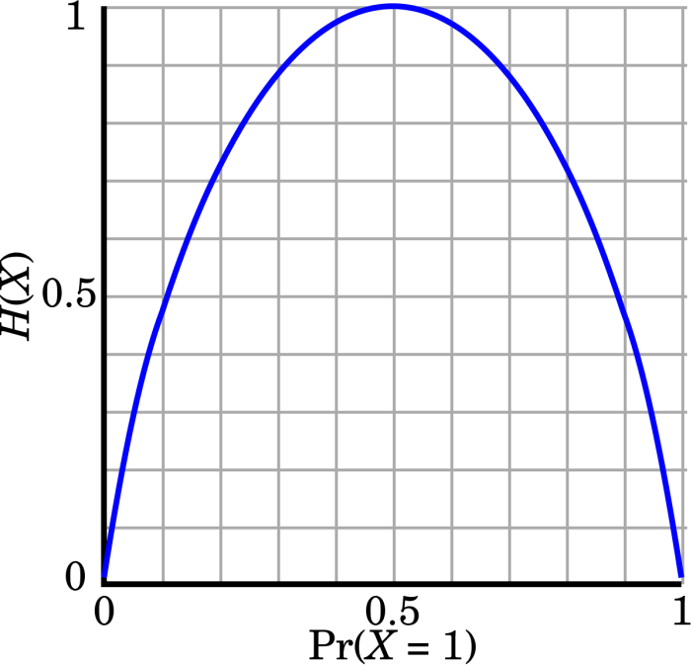
Decision Tree
Calculating Entropy
Entropy(s) = - P(yes) log₂ P(yes) − P(no) log₂ P(no)
Where,
S is the total sample space,
P(yes) is probability of yes
If number of yes = number of no ie P(S) = 0.5
Entropy(s) = 1
If it contains all yes or all no ie P(S) = 1 or 0
Entropy(s) = 0

Slide 22
Decision Tree
Calculating Entropy - Example
D1 D2 D3 D4 D5 D6 D7 D8 D9 D10 D11 D12 D13 D14
14 instances: 9 YES and 5 NO
So we have the formula,
E(S) = -P(Yes) log₂ 𝑃(𝑌𝑒𝑠) − P(No) log₂ 𝑃(𝑁𝑜)
E(S) = - (9/14)* log₂ 9/14 - (5/14)* log₂ 5/14
E(S) = 0.41+0.53 = 0.94

Slide 23
Decision Tree
Calculating Entropy - Example
D1 D2 D3 D4 D5 D6 D7 D8 D9 D10 D11 D12 D13 D14
If S: total collection,
Information Gain = Entropy(S) – [(Weighted Avg)
x Entropy(each feature)]

Slide 24
Decision Tree
Calculating Entropy - Example
D1 D2 D3 D4 D5 D6 D7 D8 D9 D10 D11 D12 D13 D14
Outlook?
Temperature?
Humidity?
Windy?

Slide 25
Decision Tree
Calculating Entropy - Example
D1 D2 D3 D4 D5 D6 D7 D8 D9 D10 D11 D12 D13 D14
Outlook?
Sunny
Overcast
Rainy
Yes Yes No No
Yes Yes Yes Yes
Yes Yes Yes No
No
No

Slide 26
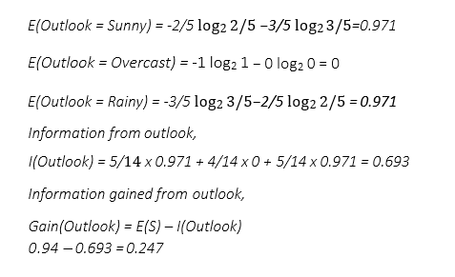
Decision Tree
Calculating Entropy - Example
D1 D2 D3 D4 D5 D6 D7 D8 D9 D10 D11 D12 D13 D14

Slide 27
Decision Tree
Calculating Entropy - Example
D1 D2 D3 D4 D5 D6 D7 D8 D9 D10 D11 D12 D13 D14
Outlook
Outlook?
?
Overcast
?
Yes
?
?
Outlook = overcast
Contains only yes

Slide 28
Decision Tree
Calculating Entropy - Example
D1 D2 D3 D4 D5 D6 D7 D8 D9 D10 D11 D12 D13 D14
Outlook
Windy?
?
True
?
False
Yes Yes Yes Yes Yes Yes No No
Yes Yes Yes No No No

Slide 29
Decision Tree
Calculating Entropy - Example
D1 D2 D3 D4 D5 D6 D7 D8 D9 D10 D11 D12 D13 D14
Outlook
E(Windy = True) = 1
E(Windy = False) = 0.811
?
Information from windy,
I(Windy) = 8/14 x 0.811+ 6/14 x 1 = 0.892
Information gained from windy,
Gain(Windy) = E(S) – I(Windy) 0.94 – 0.892 = 0.048

Slide 30
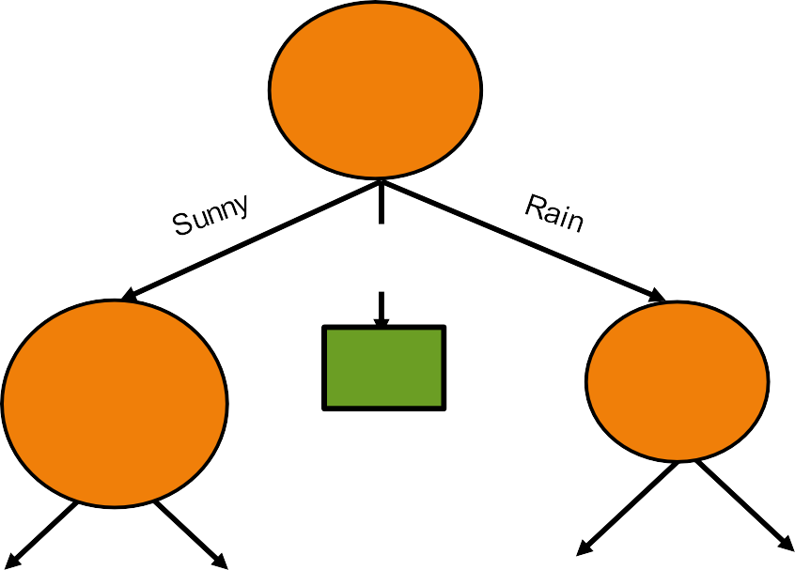
Decision Tree
Calculating Entropy - Example
D1 D2 D3 D4 D5 D6 D7 D8 D9 D10 D11 D12 D13 D14
Outlook
Outlook
Overcast
Yes
Humidity
Yes
Windy
?
High
Normal
Strong
Weak
No
Yes
No
Yes

Slide 31
Random Forest
<Topic>

Slide 32
Random Forest
Did you know that?
Decision trees have been around for a long time and also known to suffer from bias and variance. You will have a large bias with simple trees and a large variance with complex trees.
Ensemble methods, which combines several decision trees to produce better predictive performance than utilizing a single decision tree

Slide 33
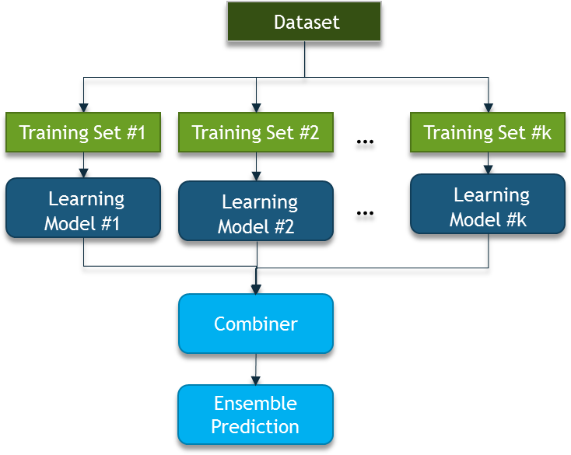
Random Forest
Ensemble Methods

Slide 34
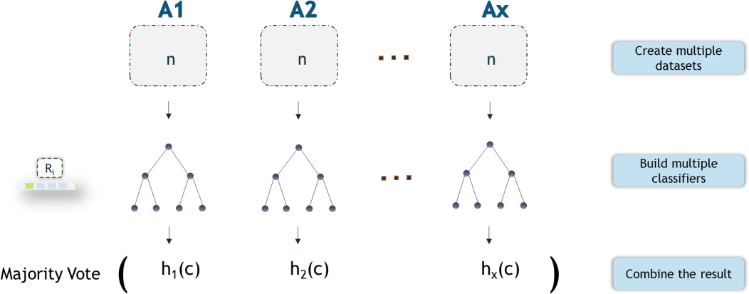
Random Forest
Bagging
It is a technique to perform ensemble decision trees
Used when our goal is to reduce the variance of a decision tree
Idea is to create several subsets of data from training sample chosen randomly with replacement
Each collection of subset data is used to train their decision trees ending up with an ensemble of different models

Slide 35

Random Forest
Decision Tree
Random Forest
In comparison, the Random Forest algorithm randomly selects observations and features to build several decision trees and then averages the results
Random Forest prevents overfitting most of the time, by creating random subsets of the features and building smaller trees using these subsets
If we input a training dataset with features and labels into a decision tree, it will formulate some set of rules, which will be used to make the predictions
Deep Decision Trees might suffer from overfitting

Slide 36
Random Forest
How does random forests work?
01
The algorithm creates random subsets with random values from the complete dataset
02
From each subset, it creates a decision tree. Each tree is built from a sample
03
So, it creates multiple decision trees and then merge the results

Slide 37
Random Forest
How does random forests work?
04
Sampling is done on the training dataset. Every time, a new sample is chosen to build the tree. This introduction of randomness increases the bias and reduces the variances of the model
05
This prevents the overfitting of the model which is a serious concern in the case of decision trees
06
This yields much better performing generalized models

Slide 38
Important Hyperparameters in Random Forest
The Hyperparameters in random forest are either used to increase the predictive power of the model or to make the model faster
n_estimators hyperparameter is the number of trees the algorithm builds before taking the maximum voting or taking averages of predictions.
max_features is the maximum number of features Random Forest considers to split a node.
min_sample_leaf determines the minimum number of leafs that are required to split an internal node.
Increasing the Predictive Power

Slide 39
Random Forest
Important Hyperparameters in Random Forest
The Hyperparameters in random forest are either used to increase the predictive power of the model or to make the model faster
n_jobs hyperparameter tells the engine how many processors it is allowed to use.
random_state makes the model’s output replicable.
oob_score also called oob sampling, which is a random forest cross validation method. In this sampling, about one-third of the data is not used to train the model and can be used to evaluate its performance.
Increasing the Models Speed

Slide 40
Random Forest
This is out Weather dataset

Slide 41
Random Forest
The first step in Random Forest is that it will divide the data into smaller subsets
Every subset need not be distinct, some may overlap
For each subset a decision tree is made

Slide 42
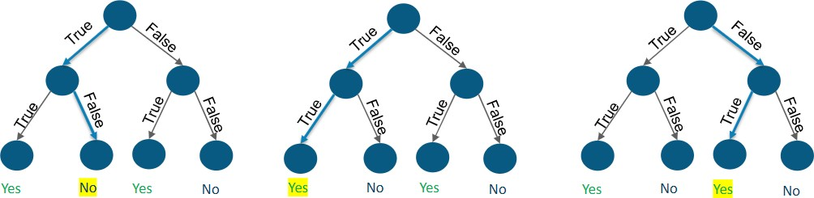
Random Forest
Output of each tree will be predicted and if any two decision trees predicted that game will happen while one predicted that it won’t happen then on the basis of number of votes final output is selected, son in this case ‘the game will happen’

Slide 43


Thank You

